Slide 2
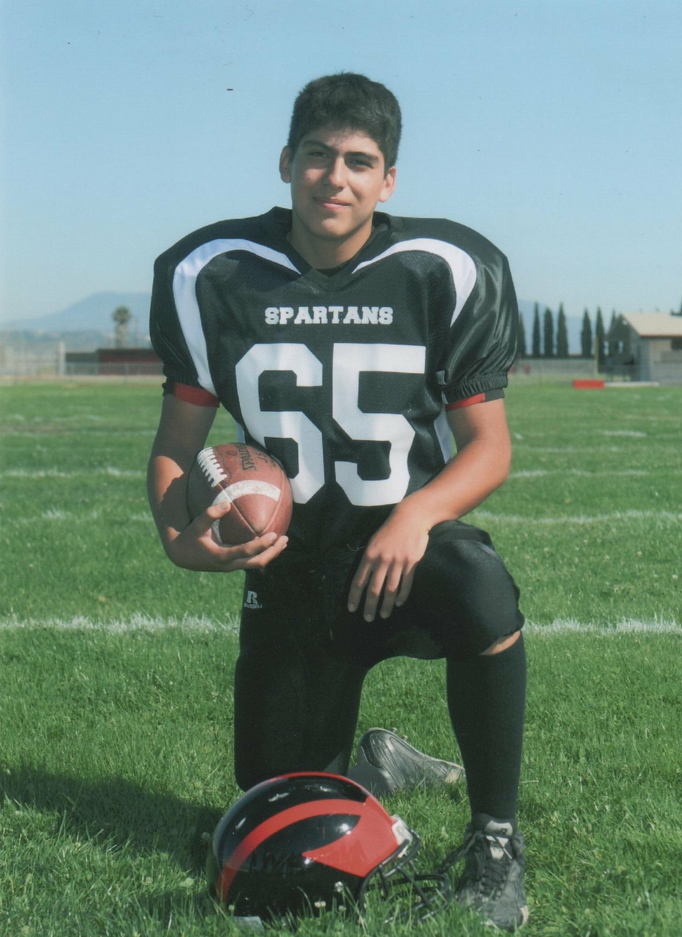

Slide 3
What does it mean to FEAR God?

Slide 4
What does it mean to FEAR God?
It Means that I don’t have to be AFRAID anymore

Slide 5
Matthew 10:26-30 (esv)
26 “So have no fear of them, for nothing is covered that will not be revealed, or hidden that will not be known. 27 What I tell you in the dark, say in the light, and what you hear whispered, proclaim on the housetops. 28 And do not fear those who kill the body but cannot kill the soul. Rather fear him who can destroy both soul and body in hell.[h] 29 Are not two sparrows sold for a penny? And not one of them will fall to the ground apart from your Father. 30 But even the hairs of your head are all numbered.

Slide 6
What does it mean to FEAR God?
It Means that I don’t have to be AFRAID anymore
It means I’m convinced of His GOODNESS

Slide 7
Ezekiel 32:39-41 (esv)
39 I will give them one heart and one way, that they may fear me forever, for their own good and the good of their children after them. 40 I will make with them an everlasting covenant, that I will not turn away from doing good to them. And I will put the fear of me in their hearts, that they may not turn from me. 41 I will rejoice in doing them good, and I will plant them in this land in faithfulness, with all my heart and all my soul

Slide 8
Ezekiel 33:8-9 (esv)
8 I will cleanse them from all the guilt of their sin against me, and I will forgive all the guilt of their sin and rebellion against me. 9 And this city shall be to me a name of joy, a praise and a glory before all the nations of the earth who shall hear of all the good that I do for them. They shall fear and tremble because of all the good and all the prosperity I provide for it.

Slide 9
Big Idea
To have the PROPER FEAR of God is to WORSHIP God

